Slide 1
FACADE
Design Pattern
Gherasim Delia-Catalina 933
Felecan Maria-Iulia 933
Bobes Bianca 931

Slide 2
Table of Contents
01
02
03
04
Theoretical Overview
Gherasim Delia
Example 1
Felecan Maria
Example 2
Bobes Bianca
Resources

Slide 3
01
Theoretical Part
Structural design pattern that provides a unified interface to a set of interfaces in a subsystem

Slide 4
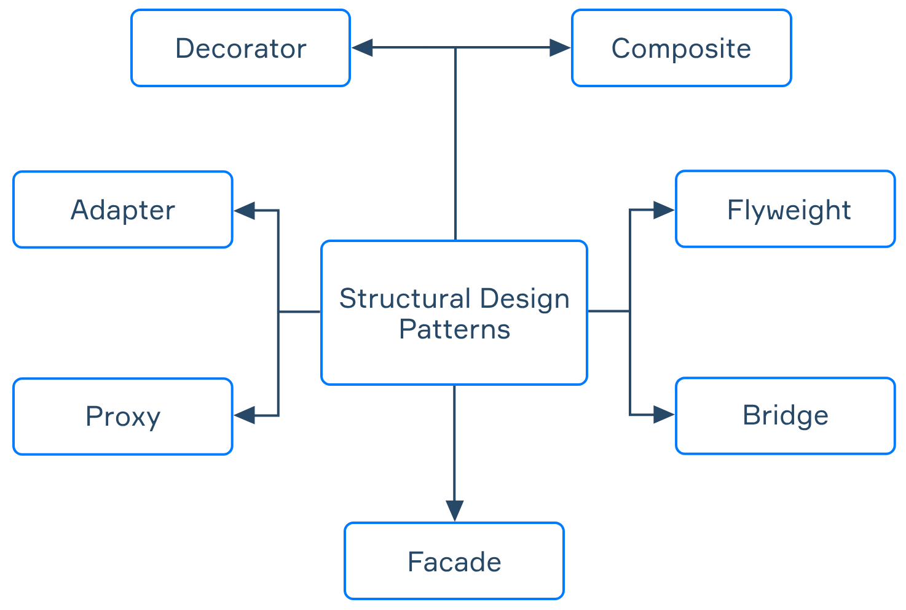
Structural Patterns
https://hyperskill.org/learn/step/17649
Explain how to assemble objects and classes into larger structures, while keeping these structures flexible and efficient.
Notes:
Structural patterns are useful in making independent classes work together. They describe ways to compose objects in order to obtain a new functionality.

Slide 5
Facade is a structural design pattern that provides a simplified interface to any complex set of classes
Refactoring of the subsystem will not affect the client code
Very useful for integrating a complex library from which you only need a few functionalities
Reduce dependencies by defining clear boundaries between subsystems

Slide 6
Analogy
Architecture
Digital Camera
Car
Facade: building exterior
Subsystem: internal structural elements
Client:person entering through the door
Facade: “Capture” button
Subsystem: lens, shutter, image sensor, processor, storage
Client: user pressing the button
Facade: Start/Stop button
Subsystem: engine, electrical
Client: the driver starting the car
Notes:
In architecture, a facade is the front-facing exterior of a building, usually designed to look appealing and provide a clear, cohesive "face" to the structure. It hides all the internal structural elements, wiring, plumbing, and rooms behind it. A building Facade makes the building approachable & attractive, while the design pattern makes the system easier to use & understand

Slide 7
Structure
the Client uses the facade instead of the subsystem
the Subsystem is made up of multiple objects
SUBSYSTEM
An Additional Facade can be added!
CLIENT
FACADE
the Facade provides access to particular subsystem functionalities
Notes:
This pattern involves a single class which provides simplified methods required by client and delegates calls to methods of existing system classes.
The Facade provides convenient access to a particular part of the subsystem’s functionality. It knows where to direct the client’s request and how to operate all the moving parts.
The Complex Subsystem consists of dozens of various objects. To make them all do something meaningful, you have to dive deep into the subsystem’s implementation details, such as initializing objects in the correct order and supplying them with data in the proper format. Subsystem classes aren’t aware of the facade’s existence. They operate within the system and work with each other directly.

Slide 8
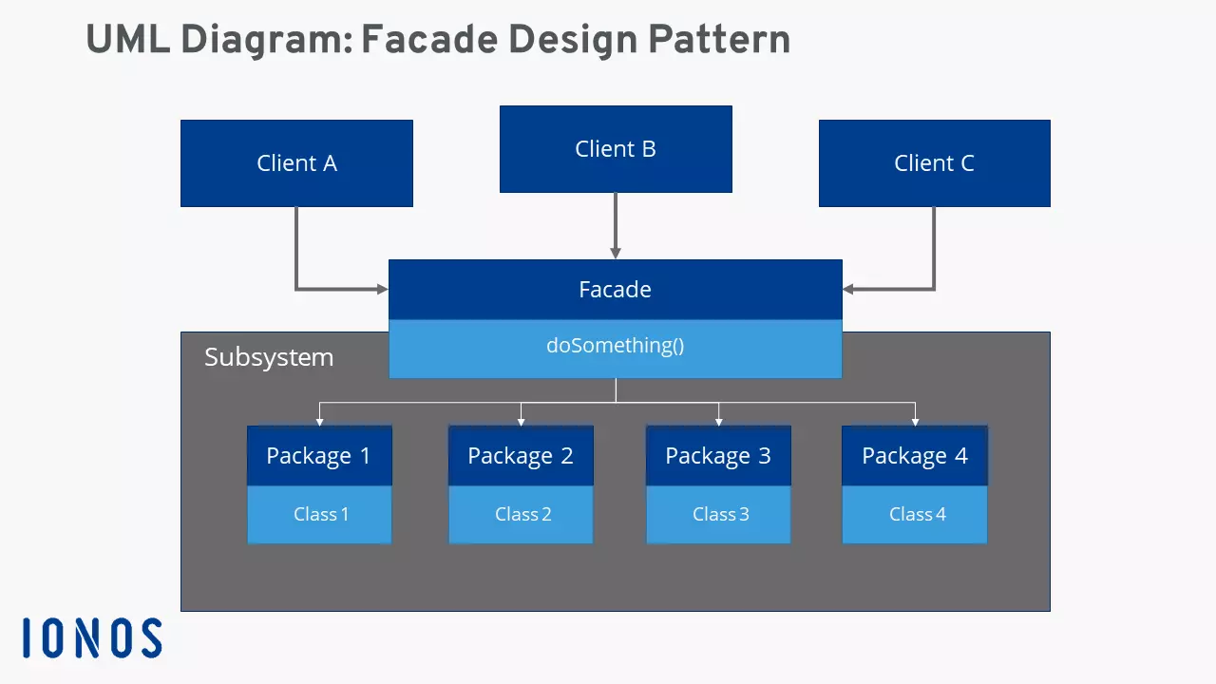
Awesome Words
https://www.ionos.com/digitalguide/websites/web-development/whats-the-facade-pattern/

Slide 9
Use Cases
Use the Facade when you want to structure a subsystem into layers.
When you need to have a limited but straightforward interface to a complex subsystem.
When you plan software projects that have multiple layers
Notes:
Create facades to define entry points to each level of a subsystem. You can reduce coupling between multiple subsystems by requiring them to communicate only through facades.
A subsystem may become more flexible and easier to reuse in various contexts, but the amount of configuration and code it demands from a client grows larger. The Facade attempts to fix this problem by providing a shortcut to the most-used features of the subsystem which fit most client requirements.
The facades act as communication interfaces between the individual layers, increasing flexibility and the possibility of extension and adaptation of components.

Slide 10
PROS AND CONS
+
-
Reduced complexity
Promote the Principle of Loose Coupling
The system is flexible and expandable
Complex implementation
Additional indirection
High degree of dependence at interface
Notes:
The facade hides underlying complex subsystems, therefore reducing complexity. In addition, the approach promotes the principle of loose coupling. Due to the low degree of interdependence of the individual components, changes (modifications, maintenance) are convenient and possible at any time. Because of loose coupling a sub-system is easier to expand.
In general, the installation of a facade interface requires an additional indirection stage, that in turn increases computing time for method and function calls and memory access. Finally, the facade pattern also harbors the risk that the software becomes too dependent on the central master interface.

Slide 11
02
First Example

Slide 12
DiscoveryClient.java
From the Netflix Open Source Platform
What is it?
The main Eureka client used for service discovery.
Implementation of the EurekaClient interface
Eureka Server
Microservice 1
Thread Management
Instance Registry
Microservice 2
DiscoveryClient
HTTP Client
Eureka Transport
Microservice 3
Notes:
The DiscoveryClient class in Eureka is a perfect example of the Facade Design Pattern. It provides a simple interface for service discovery while hiding the complexity of multiple subsystems.
Netflix has a lot of microservices. These microservices are designed to handle different functionalities, such as user management, content delivery, recommendations, and more.
Eureka is a service discovery tool used by Netflix to manage how microservices communicate with each other.
Every microservice connects to the DiscoveryClient class that communicates with the Eureka Server.
Internally, DiscoveryClient interacts with different components such as
Instance Registry: Keeps track of all available services
Cache Manager: Ensures fast lookups of registered services
HTTP Client: Handles network communication with the Eureka server.
Thread Management: Runs background tasks for updates and cleanup
It registers itself with the server to let other services know it is available. It also looks up other services in Eureka when it needs to communicate with them.
DiscoveryClient provides users with simple functions they can call in order to achieve complex tasks, without having to worry about the management of the subsystems involved, as I will present in the next slides.

Slide 13
Behind the scenes
Thread Safety
private final AtomicReference<Applications> localRegionApps = new AtomicReference<>();
private final Lock fetchRegistryUpdateLock = new ReentrantLock();
private final Map<String, Applications> remoteRegionVsApps = new ConcurrentHashMap<>();
Remote Communication
private final EurekaTransport eurekaTransport;
private final EurekaHttpClient registrationClient;
private final EurekaHttpClient queryClient;
Cache management
private boolean fetchRegistry(boolean forceFullRegistryFetch)
Background Tasks
private void initScheduledTasks()
Notes:
Clients can focus on their core functionality without worrying about the underlying complexity of distributed systems, thread safety, and remote communication.
Thread Safety: class handles concurrent access without exposing synchronization details to clients
Remote Communication: clients don’t worry about managing the HTTP connection, about request/response handling
Cache management: clients dont know about clearing outdated data or managing the backup of the data
Background tasks: configuration of the thread pool, coordinates tasks and manages executions

Slide 14
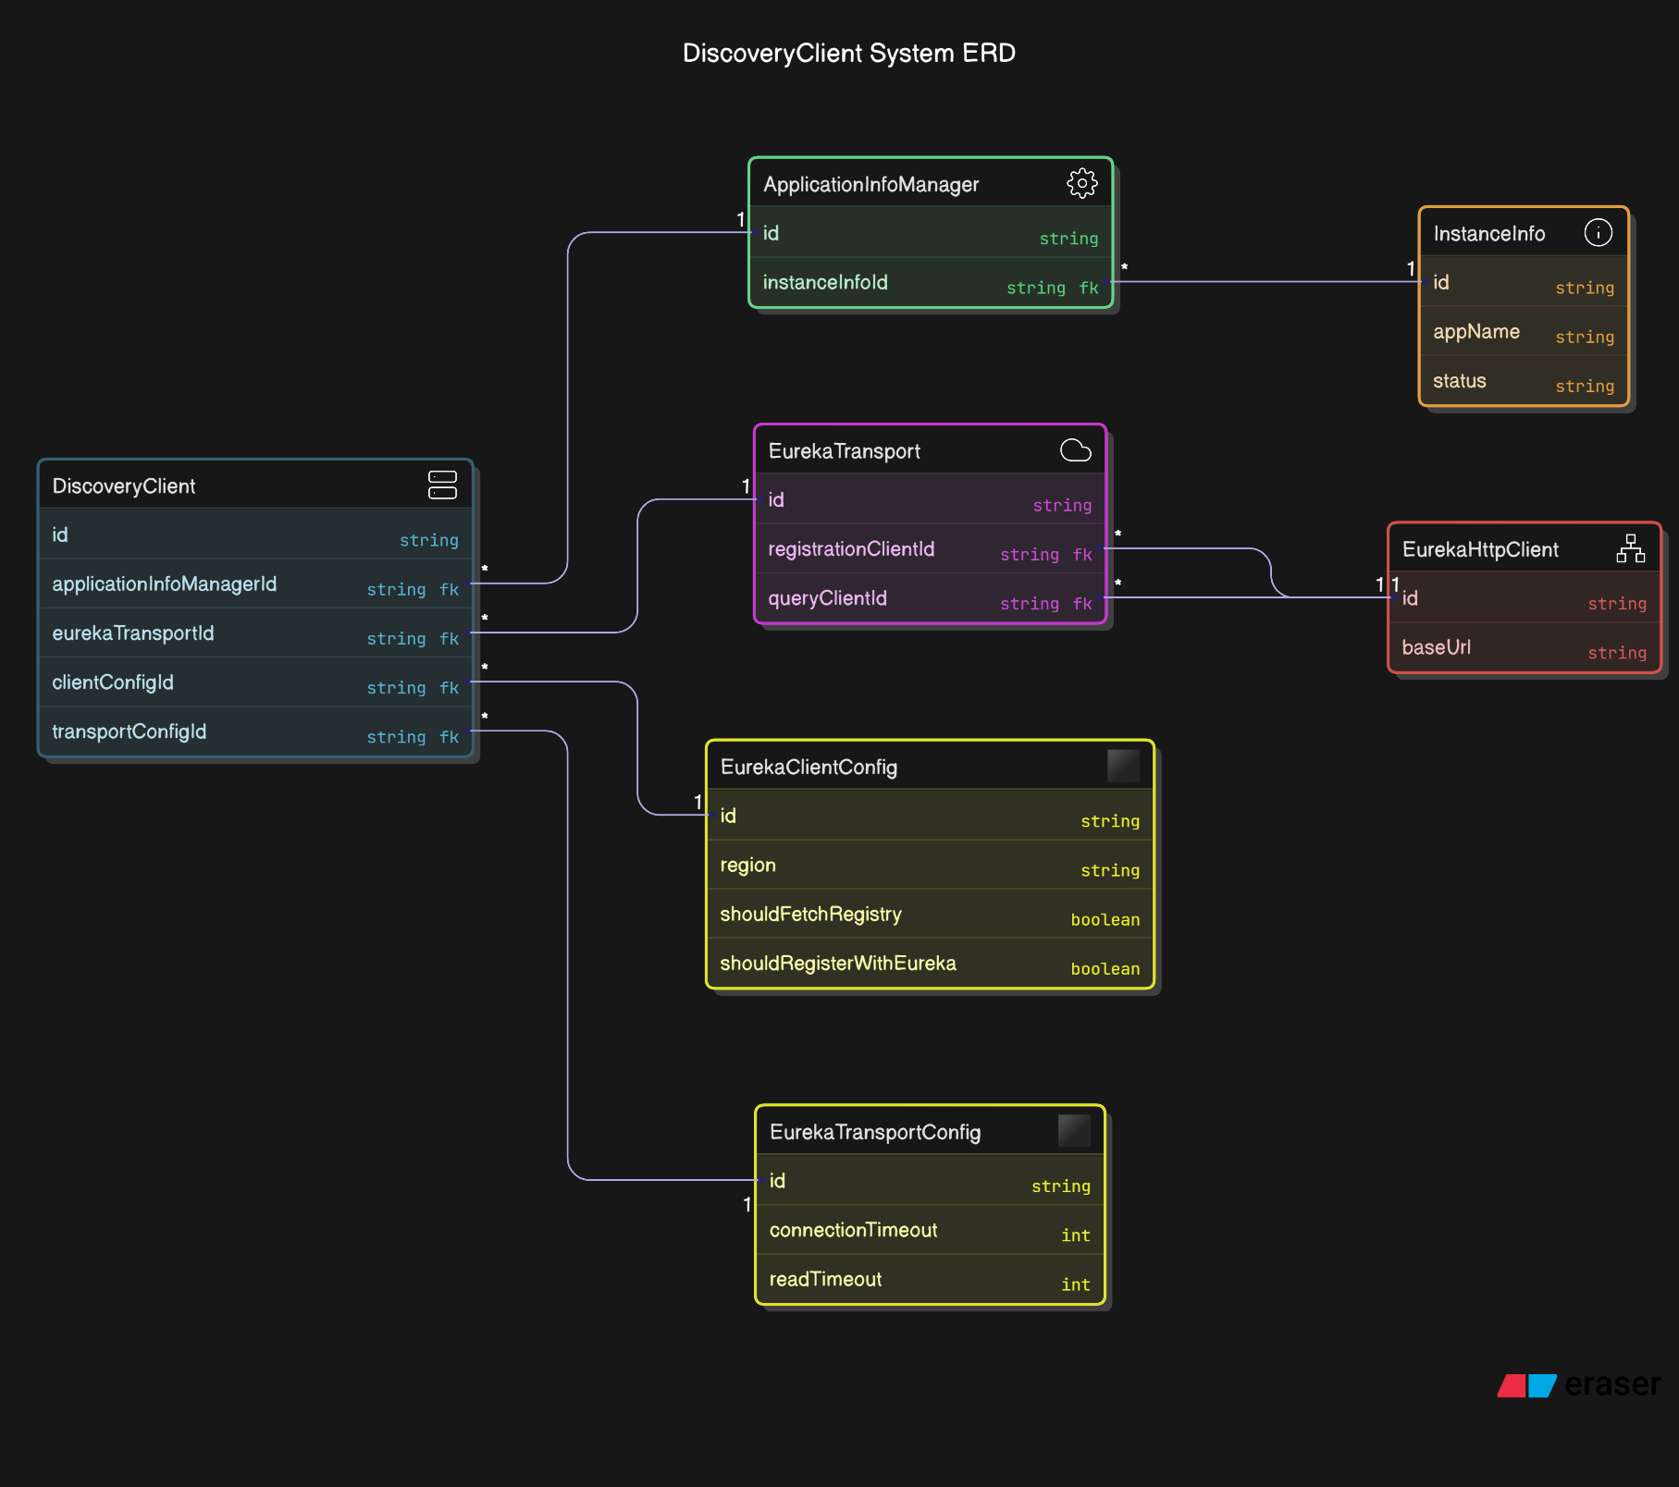

Slide 15
renew() : provides a unified interface to handle the complete heartbeat renewal process, hiding the complexity of subsystem interactions from clients.
boolean renew() {
EurekaHttpResponse<InstanceInfo> httpResponse;
try {
httpResponse = eurekaTransport.registrationClient.sendHeartBeat(instanceInfo.getAppName(), instanceInfo.getId(), instanceInfo, null);
logger.debug(PREFIX + "{} - Heartbeat status: {}", appPathIdentifier, httpResponse.getStatusCode());
if (httpResponse.getStatusCode() == Status.NOT_FOUND.getStatusCode()) {
REREGISTER_COUNTER.increment();
it coordinates with the logging subsystem to maintain the transaction history:
logger.info(PREFIX + "{} - Re-registering apps/{}", appPathIdentifier, instanceInfo.getAppName());
long timestamp = instanceInfo.setIsDirtyWithTime();
boolean success = register(); <- it then registers the service instance with the Eureka server
if (success) {
instanceInfo.unsetIsDirty(timestamp); <- maintains instance metadata using InstanceInfo subsystem
}
return success; <- provides a simple success message to the client
}
return httpResponse.getStatusCode() == Status.OK.getStatusCode();
} catch (Throwable e) {
logger.error(PREFIX + "{} - was unable to send heartbeat!", appPathIdentifier, e);
return false;}}
< - establishes connection to the Eureka server, manages connection lifecycle
Notes:
"Now, let’s look at how the renew() method works. This method is crucial because it sends a heartbeat to the Eureka server, letting it know that an instance is still alive."
Heartbeats in Eureka are messages that instances send to the Eureka server to maintain their registration and indicate they are still alive and operational.
First, notice the simple signature: boolean renew(). This single method provides a unified interface to multiple complex subsystems, like the definition of the design pattern says.
renew() calls an internal HTTP method to send a renewal request to the Eureka server
If the response is successful (HTTP 200), the instance remains registered. If it fails, DiscoveryClient handles retries and logs errors
“Imagine if every client had to manually manage retries and cache—wouldn’t that be a nightmare?”
Clients don’t have to manually handle failures or retries; DiscoveryClient does it for them
The Eureka Transport Subsystem handles network communication and manages heartbeat messages.
The Logging Subsystem manages the audit trail, the registration system manages service registration and the instanceInfo subsystem maintains instance metadata and tracks instance state.
This implementation demonstrates the Facade pattern:
Clients only need to call renew() and check the boolean result, while the complexity is encapsulated.
Http communication details are hidden, registration logic is encapsulated, state management is abstracted and all subsystem errors are caught and handled.

Slide 16
getInstancesByVipAddressAndAppName() : helps find specific service instances in a system by matching them against either their VIP address or application name
for (Application app : getApplications().getRegisteredApplications()) {
for (InstanceInfo instance : app.getInstances()) {
if (secure) {
instanceVipAddress = instance.getSecureVipAddress();
} else {
instanceVipAddress = instance.getVIPAddress();
}
if (instanceVipAddress == null) {
continue;
}
String[] instanceVipAddresses = instanceVipAddress
.split(COMMA_STRING);
for (String vipAddressFromList : instanceVipAddresses) {
if (vipAddress.equalsIgnoreCase(vipAddressFromList.trim())
&& appName.equalsIgnoreCase(instance.getAppName()))
result.add(instance);
break;}}}}
return result;}
public List<InstanceInfo> getInstancesByVipAddressAndAppName(..) {
List<InstanceInfo> result = new ArrayList<>();
if (vipAddress == null && appName == null) {
throw new IllegalArgumentException(“...”);}
else if (vipAddress != null && appName == null) {
return getInstancesByVipAddress(vipAddress, secure); }
else if (vipAddress == null && appName != null) {
Application application = getApplication(appName);
if (application != null) {
result = application.getInstances();
} return result;}
Notes:
This method helps clients find instances of a service by its VIP address or application name. Let’s break it down
First, it checks if the requested data is cached to avoid unnecessary network calls
If the data is outdated or missing, it makes an HTTP request to Eureka to fetch fresh data
The response is parsed and stored in the local cache for future use. The method then returns the list of instances to the client
The client only needs to call one method
All subsystem interactions are handled internally by the facade
Complexity of subsystem interactions is completely hidden
so the function automatically handles:
Facade orchestrating complex interactions with multiple subsystems:
// 1. Application Registry (getApplications)
// 2. Instance Management (getInstances)
// 3. VIP Address Management (getVIPAddress/getSecureVipAddress)

Slide 17
03
Second Example
…..

Slide 18
RestTemplate
from Spring Framework
Spring App
Developer facing code
RestTemplate
FACADE
URI Builder
HTTP Client
JSON Converter
Error Handler
RestTemplate is a class from the Spring Framework used to make HTTP requests.
Notes:
Continuing after the previous real-world example, I’ll now introduce another practical use of the Facade pattern – this time from the Spring Framework, which many of us have used or will likely use in backend development.
The class at the center of this example is RestTemplate. It acts as a facade, hiding the complexity involved in making HTTP requests.
Instead of manually handling multiple concerns like building URIs, sending HTTP requests, parsing JSON, and handling errors, developers can simply use methods like getForObject() or postForEntity().
Under the hood, RestTemplate integrates with four key components:
A URI Builder
An HTTP client
A JSON converter
And an Error handler
This makes it an excellent real-life implementation of the Facade design pattern, simplifying a complex system into a single, unified interface for developers."

Slide 19
Behind the scenes of RestTemplate.getForObject()
How one method hides the complexity of HTTP requests using the Facade pattern
HTTP Request Creation
private final ClientHttpRequestFactory requestFactory;
Message Conversion
private List<HttpMessageConverter<?>> messageConverters;
URI Expansion & Encoding
private URI expandAndEncodeUrl(String url, Object... variables);
Error Handling
private ResponseErrorHandler errorHandler;
Notes:
Now let’s take a closer look at what happens behind the scenes when we call one of the most commonly used methods: RestTemplate.getForObject().
This single method call might look simple, but it delegates several responsibilities to multiple internal components:
HTTP Request Creation: This is handled by the ClientHttpRequestFactory, which manages the actual HTTP connection and allows different implementations like Apache or OkHttp.
Message Conversion: This is where the HTTP response is converted into Java objects using HttpMessageConverters. It typically relies on libraries like Jackson or Gson.
URI Expansion & Encoding: The method expandAndEncodeUrl() automatically handles URI templates and encodes the URL safely.
Error Handling: If something goes wrong, ResponseErrorHandler is triggered to check for non-2xx responses and throw appropriate exceptions like RestClientException.
So even though developers only see one simple method, the actual logic is distributed across multiple subsystems – all coordinated by the Facade.

Slide 20
Code Walkthrough: RestTemplate.getForObject()
Developer Usage (Facade Interface)
RestTemplate restTemplate = new RestTemplate();
String result = restTemplate.getForObject("https://api.example.com/user/1", String.class);
Internal Implementation (Facade Coordinates Subsystems)
@Override
public <T> @Nullable T getForObject(String url, Class<T> responseType, @Nullable Object... uriVariables) throws RestClientException {
RequestCallback requestCallback = acceptHeaderRequestCallback(responseType);
HttpMessageConverterExtractor<T> responseExtractor =
new HttpMessageConverterExtractor<>(responseType, getMessageConverters(), logger);
return execute(url, HttpMethod.GET, requestCallback, responseExtractor, uriVariables);
}
Notes:
To reinforce how the Facade design pattern works here, let’s quickly walk through the actual code usage and how it's implemented internally.
On the top, we have the developer-facing code: restTemplate.getForObject("https://api.example.com/user/1", String.class); This is what most developers see – clean, simple, and readable.
Below is the internal implementation of the getForObject() method inside RestTemplate. It does not handle everything itself, but rather coordinates other components:
It sets up a RequestCallback, creates a ResponseExtractor, then calls execute(), passing in these objects along with the HTTP method and URI variables.
The execute() method delegates work to subsystems like the HTTP client, JSON converter, and error handler – which confirms RestTemplate's role as a true Facade

Slide 21
RestOperations + RestTemplate
Interface-driven Facade in Spring Framework
Concept
RestOperations is a Java interface.
RestTemplate implements it.
Facade Role | Spring Component
Facade Interface | RestOperations
Concrete Facade | RestTemplate
Client | Spring Boot app
Subsystems | URI Builder, HTTP Client, JSON Converters, Error Handler
Notes:
Finally, I want to briefly touch on an additional aspect of the design – the interface-based structure used in Spring’s implementation.
The RestTemplate class actually implements the RestOperations interface.
This brings us to an even more robust design, where the interface (RestOperations) acts as the Facade interface, and the RestTemplate class is the concrete Facade.
The actual Spring Boot application plays the role of the client, while the internal subsystems are:
The URI Builder
The HTTP client
The JSON converter
And the error handler
This structure makes the system flexible, extensible, and even allows developers to substitute RestTemplate with other implementations in the future – just by coding against the RestOperations interface.
So to summarize, RestTemplate not only hides complexity behind a simple API, but also follows good object-oriented design principles, such as programming to an interface

Slide 22
Resources
Theoretical
https://www.ionos.com/digitalguide/websites/web-development/whats-the-facade-pattern/
https://www.geeksforgeeks.org/facade-design-pattern-introduction/
https://www.geeksforgeeks.org/structural-design-patterns/
https://www.tutorialspoint.com/design_pattern/facade_pattern.htm
Example 1
The Story of Netflix and Microservices - GeeksforGeeks
eureka/eureka-client/src/main/java/com/netflix/discovery/DiscoveryClient.java at 015400c60d3dc730c3fc4871e9b586d3805cce0d · Netflix/eureka
Netflix Open Source Software Center
Example 2
https://github.com/spring-projects/spring-framework/blob/main/spring-web/src/main/java/org/springframework/web/client/RestOperations.java
https://github.com/spring-projects/spring-framework/blob/main/spring-web/src/main/java/org/springframework/web/client/RestTemplate.java
https://docs.spring.io/spring-framework/docs/current/javadoc-api/org/springframework/web/client/RestTemplate.html

Slide 23
Thanks!

